Slide 1
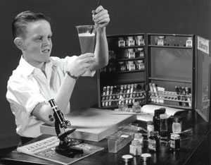
AQUATIC ECOSYSTEMS
Abiotic Elements That Affect Our Water

Slide 2
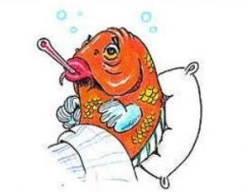
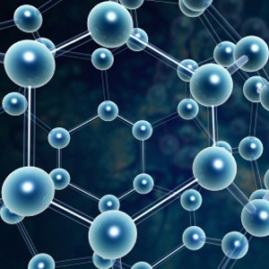
Water Chemistry
Chemical components are considered non-living or abiotic. The water chemistry has a huge influence on the living or biotic organisms present in the ecosystem.
Healthy aquatic ecosystems depend upon many factors. One important factor is the chemical balance present in the ecosystem.
Aquatic ecosystems are susceptible to many chemical changes. Usually if the chemistry of a “healthy” ecosystem changes, signs of this change will include sensitive organisms quickly declining in number or disappearing. These types of organisms are called indicator species since they alert us to problems in our aquatic ecosystem.

Slide 3
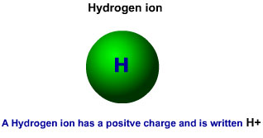
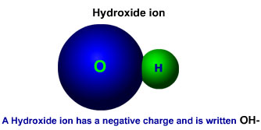
pH
Hydrogen ions are part of many chemical bonds that form many things. If a large number of hydrogen ions are active in a substance like water, they form an acidic condition.
If few active hydrogen ions exist in a substance, the substance is referred to as basic or alkaline. Alkaline substances contain more active OH (hydroxide) ions than H ions.
We use a pH scale from 1 to 14 to illustrate this. The point on the pH scale where the concentration of H ions equals the concentration of OH ions is called “neutral” since the substance is neither acidic or alkaline.

Slide 4
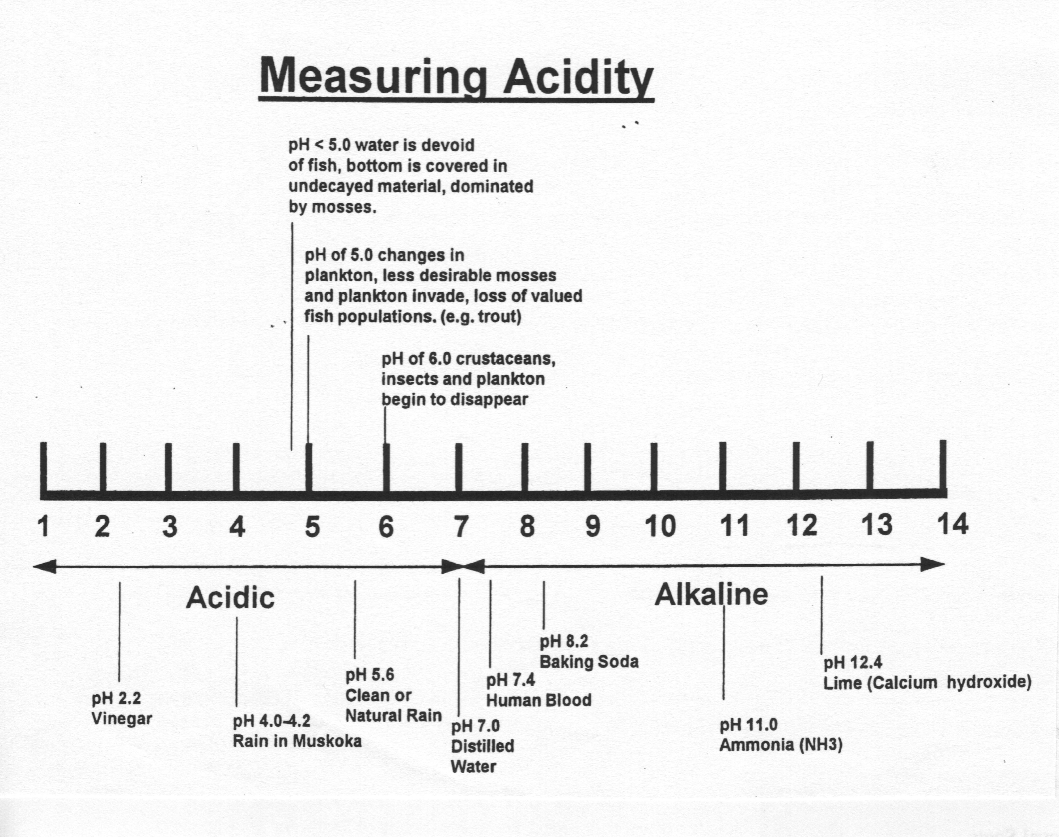
What is Acid Rain?
Rain has a natural pH of 5.6
This is due to CO₂ mixing with water to form carbonic acid in the atmosphere, lowering rainwater’s pH from 7 to 5.6. Acid precipitation is any precipitation with a pH less than 5.6.
ACIDIC
ALKALINE or BASIC
Neutral pH

Slide 5
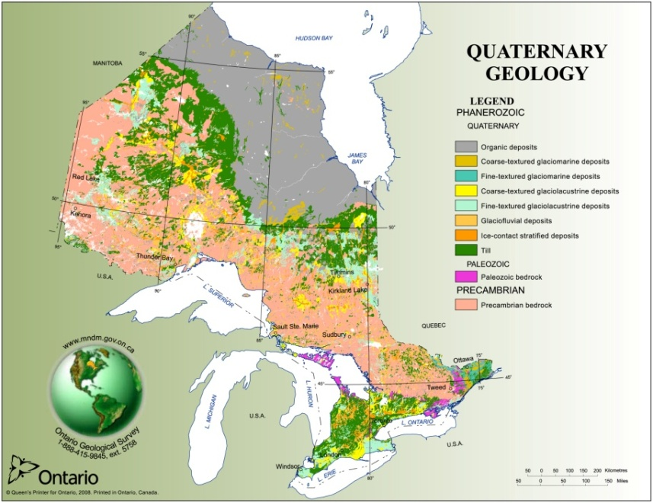
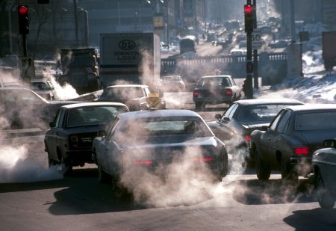
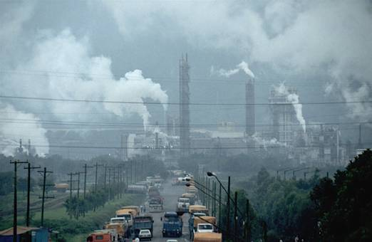
What Affects pH?
The main natural factor affecting pH is the mineral content of surrounding bedrock and soils.
Unfortunately, humans have caused large increases in sulfur dioxide and nitrogen oxide emissions due to industrial and vehicle pollution. These emissions combine with water vapour in the atmosphere and release active H ions, forming acid precipitation.
Natural areas with limestone in their soils (like we have in Southern Ontario) are able to withstand higher levels of acid precipitation. This is because limestone contains calcium carbonate, which “buffers” or lessens the effects of the extra H ions present in the precipitation. Areas with granite based soils (like we have in Northern Ontario) don’t have limestone and quickly experience the negative impacts of acid precipitation.
A pH of between 6.5 and 9 is best for freshwater lifeforms.

Slide 6
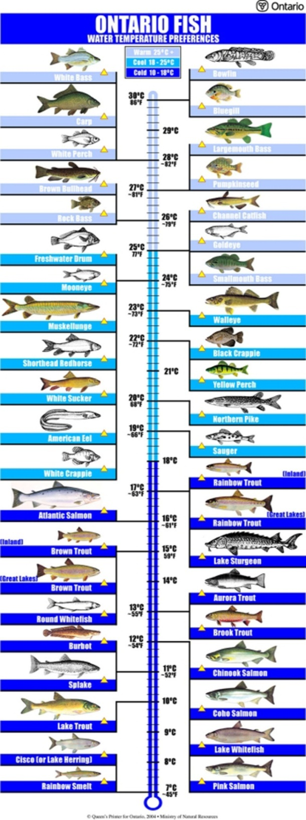
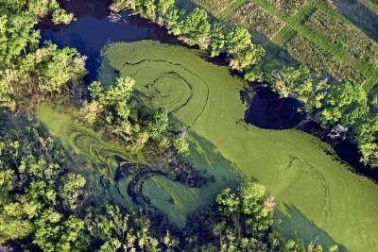
Temperature, Dissolved Oxygen and Carbon Dioxide
Higher CO2 levels allow algae and phytoplankton to grow which reduce the DO levels further when they die .
Water temperature is important since at higher temperatures the metabolism of organisms increases and more oxygen is used up.
This can lead to low dissolved oxygen (DO) levels and carbon dioxide (CO2) buildup. DO is the oxygen present in the water that organisms can use to breathe. DO is produced by submerged plants , winds, and water contact with air (rapids).
Some aquatic organisms do well in warmer temperatures and can tolerate lower oxygen levels while others need cold temperatures/high DO to survive.

Slide 7
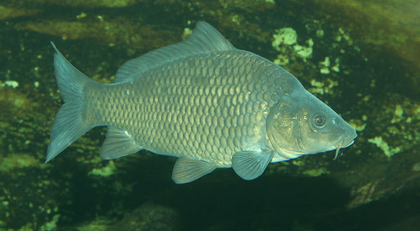
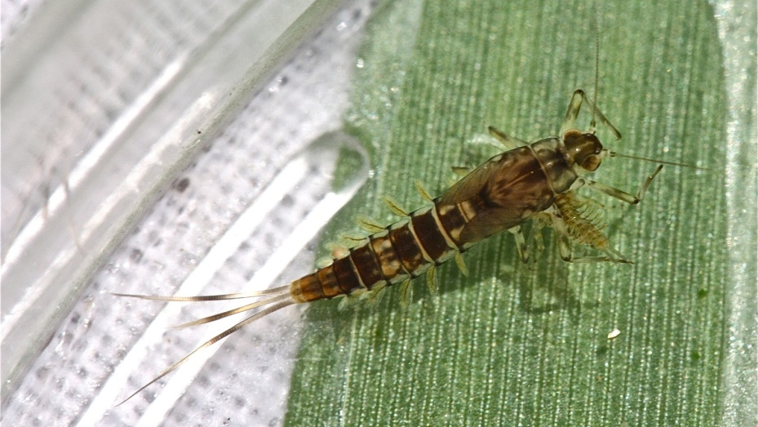
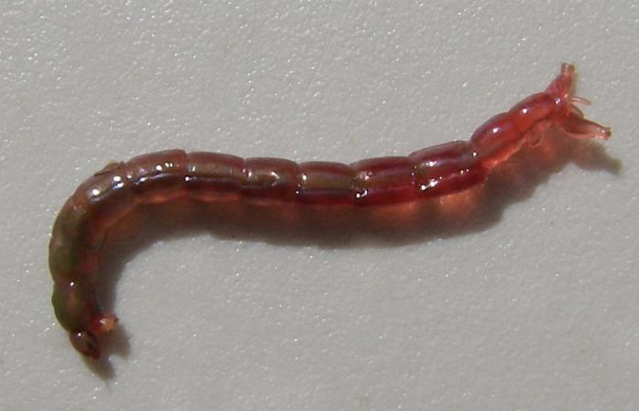
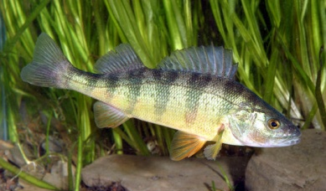
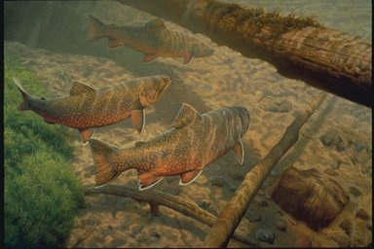
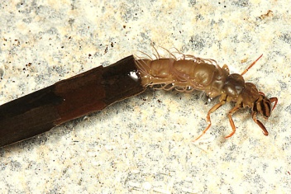
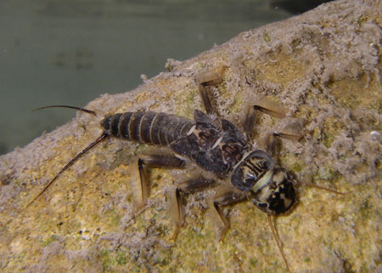
Temperature and Dissolved Oxygen Relationship
Temperature
DO
Organisms present
13 ppm
< 7 °C
27 °C
At Least
5 ppm of DO Must Be Present for A Balanced Aquatic Ecosystem!
Little vegetation, trout, stoneflies, mayflies
Excessive vegetation, catfish, carp, midge larvae (bloodworms)
15°C
10 ppm
Moderate vegetation, yellow perch, pike, caddisfly larvae
COLD
COOL
Mayfly Nymph
Midge Larva
Carp
Yellow Perch
6 ppm
WARM
Brook Trout
Caddisfly Larva
Stonefly Nymph

Slide 8
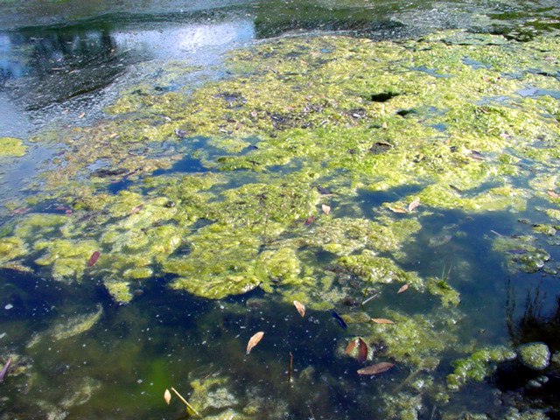
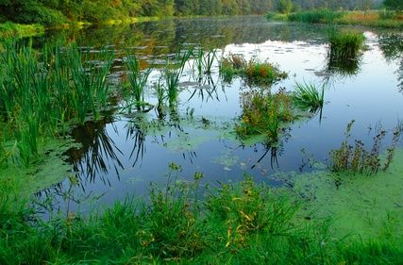
Carbon Dioxide CO2
Underwater plants need CO2 to photosynthesize.
Too much CO2 is not good for aquatic ecosystems however, since this increases acidity, decreases available DO, and leads to an excess of plant and algal growth.
Ideally, CO2 levels should be much lower than DO levels for healthy aquatic ecosystems!

Slide 9
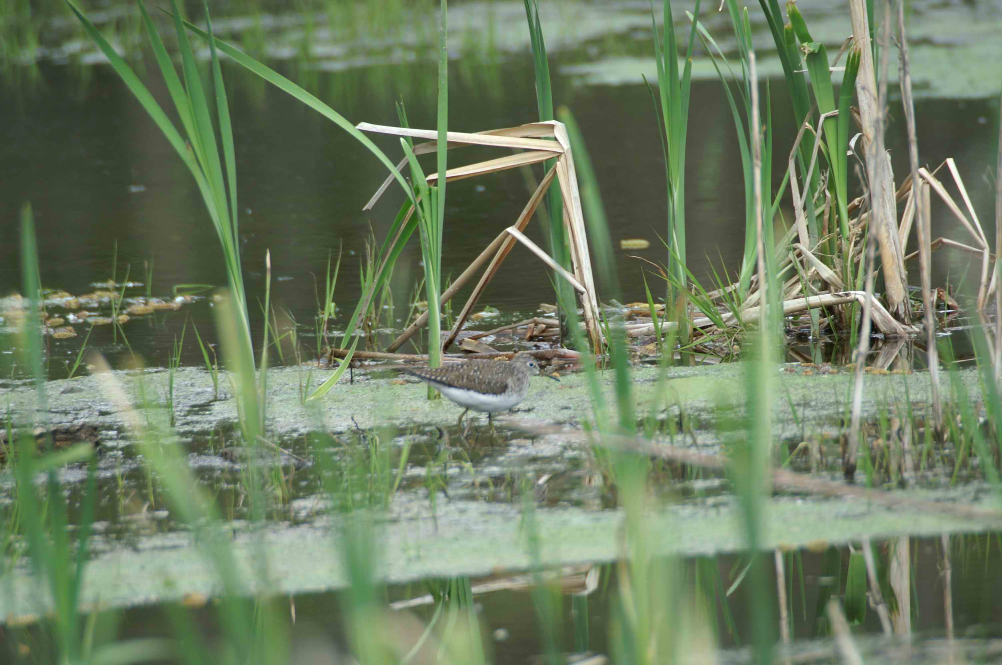
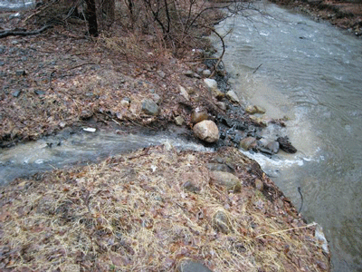
Nitrogen N
Nitrogen is present naturally in aquatic ecosystems since it is a product of decaying organic material.
Human activities increase the N levels. Chemical fertilizers, sewage and manure spills all cause high levels of N to occur.
Too much N causes excess plant growth, algal growth and a reduction of DO present in the water.
N levels should not be much higher than .3 ppm for a healthy aquatic ecosystem.
Downstream from Sewage Spill

Slide 10
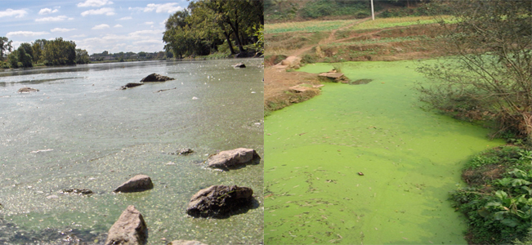
Phosphorus P
Plants require phosphorus to grow. Normally this phosphorus leaches very slowly into the waters from surrounding soils and bedrock.
Detergents and fertilizers used by us cause a large, quick increase of phosphorus in aquatic ecosystems.
Once again, too much phosphorus causes excessive plant growth and algal blooms, reducing the available DO in the water.
A P level of .015 ppm is acceptable for lakes and ponds.
Natural Phosphorus Level
Excess Phosphorus

Slide 11
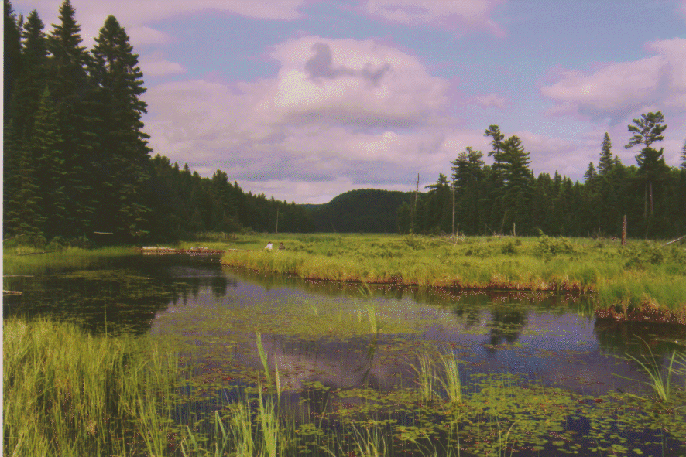
Biotic Elements of Aquatic Ecosystems

Slide 12
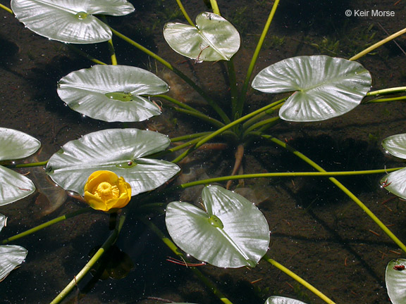
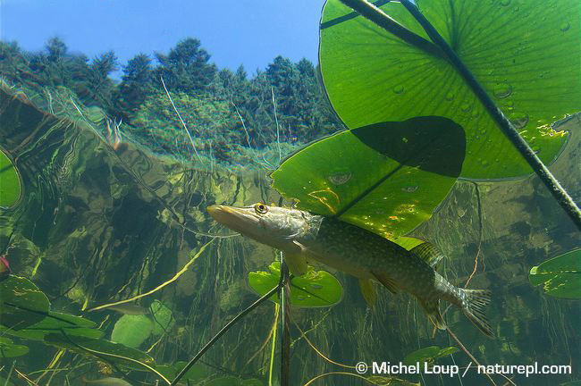
Yellow Pond or Bullhead Lily
Leaves float on the surface of the water, absorbing sunlight and shading the water.
This reduces warming and algal growth.
The leaves also provide great cover for wetland organisms!

Slide 13
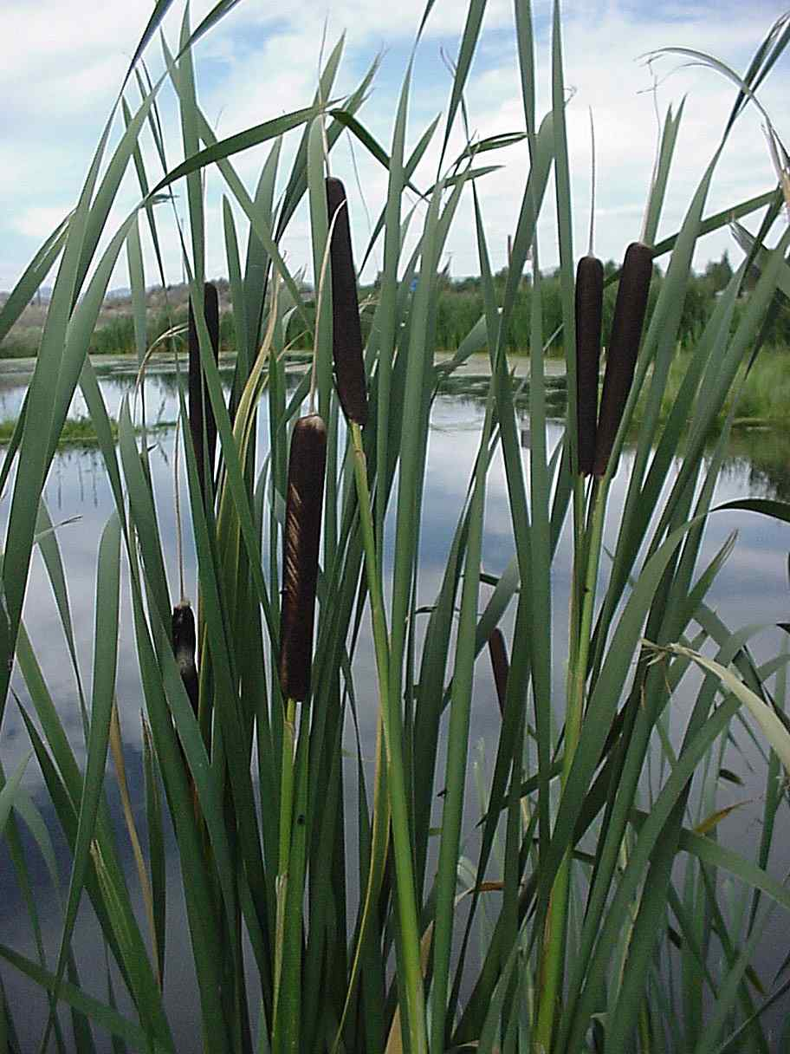
Marsh Plants are Amazing!
Plants like cattail prevent flooding by acting like sponges to store excess water.
Cattail also let water out of their tissues during droughts when the water levels are low.
Marsh plants hold the soil in place to prevent erosion.
Marsh plants act as filters to soak up and store lots of the chemicals we dump into the water.
Native wetland plants also provide habitat for huge numbers of wildlife!

Slide 14
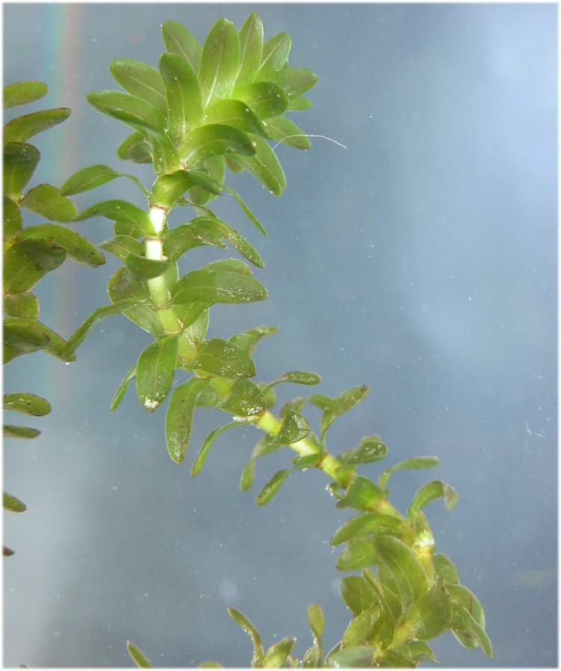
Underwater Vegetation
Many plants inhabit the subsurface waters of aquatic ecosystems.
Elodea is one example of an underwater plant that produces large amounts of dissolved oxygen for aquatic life forms. This plant acts to clean the water and remove large amounts of carbon dioxide.
Submerged plants also produce food and shelter for many types of wildlife.

Slide 15
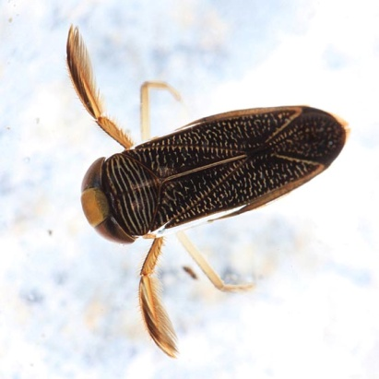
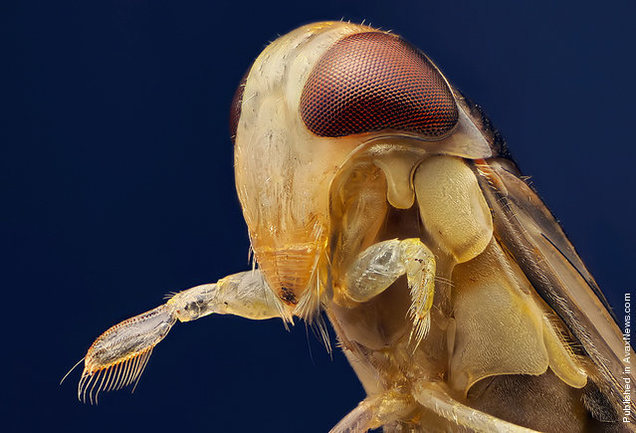
Water boatman
The small front legs help to gather food and bring it to the mouth.
The front legs are short and hard to see if you are looking down on this insect, unlike the front legs of our next guest!
These insects scavenge dead plant and animal material found and along the bottom of the wetland.

Slide 16
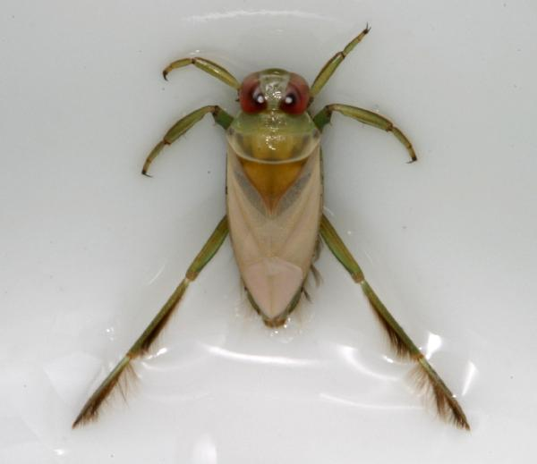
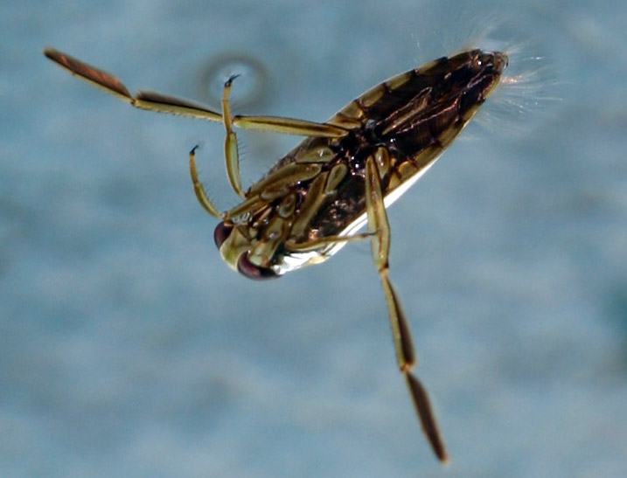
Backswimmer
These predators lie on their backs just under the water surface and use their long front legs to grab insects that land on the water.
The front legs of the backswimmer are much more visible than those of the water boatman, allowing easier identification when both are viewed from the top.

Slide 17
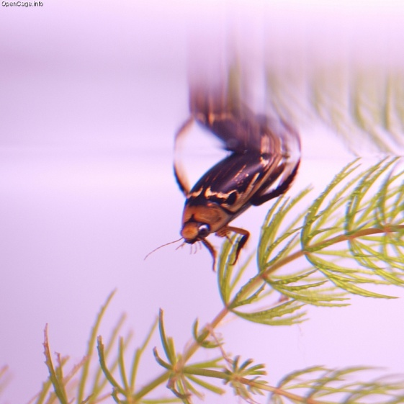
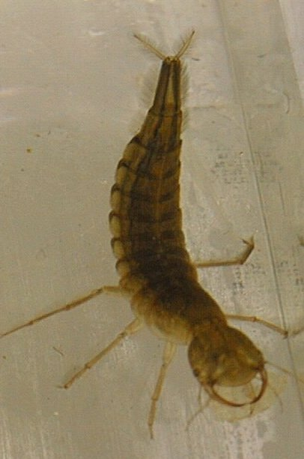
Predaceous Diving Beetle
Diving beetles are predatory insects that breathe using tubes that come out of their rear-ends! Air is obtained from the surface and stored in a space underneath their hard wing-covers created by thousands of very tiny hairs.
Adult
Just like butterflies, these beetles have complete metamorphosis. Eggs are laid close to the surface on plants and larvae that are ferocious predators hatch and eat things like mosquito larvae under the water.
Larva

Slide 18
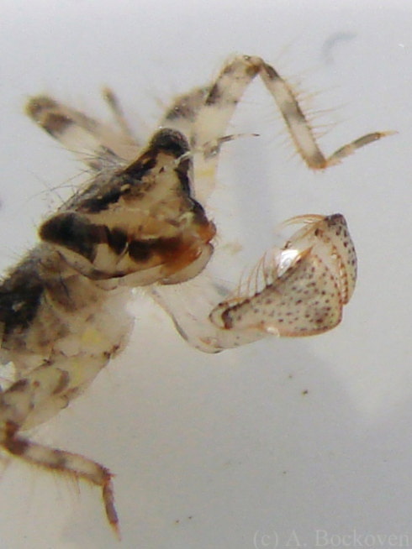
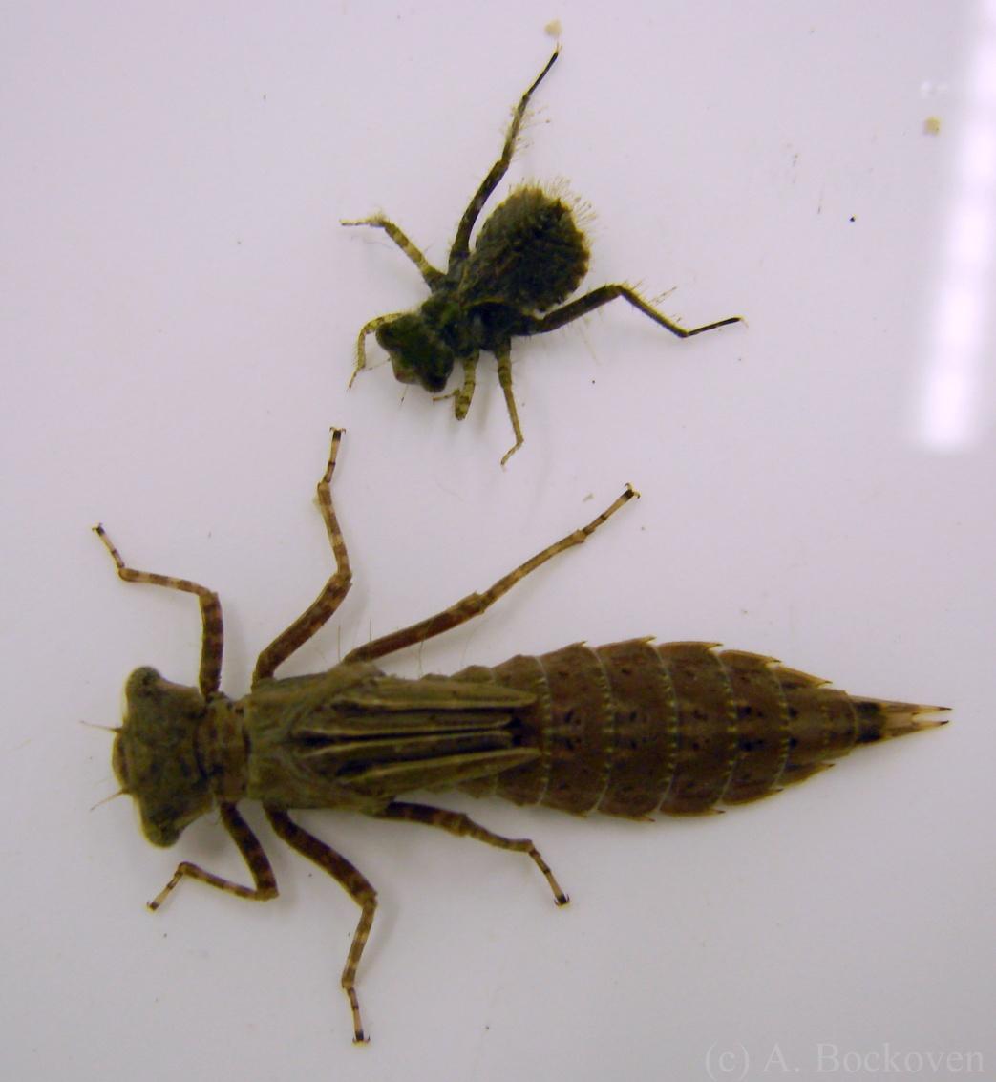
Dragonfly Nymph
Dragonflies have incomplete metamorphosis. Young dragonflies live in the water and are called nymphs. They will shed their skins many times until they finally come out of the water to become adults.
Dragonflies are great predators, and have a mouthpart called a labium that extends out and grabs their prey with sharp hooks.
The type of dragonflies we find in the water here belong to the skimmer or libellulidae family. They look like this and can be found crawling along the muddy bottom of wetlands all over Ontario.
This is good because both dragonfly nymphs and adults hunt insects like mosquitoes!

Slide 19
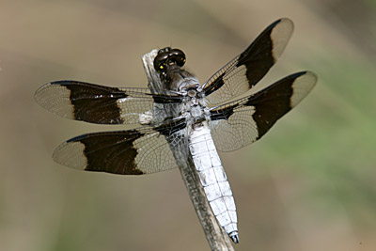
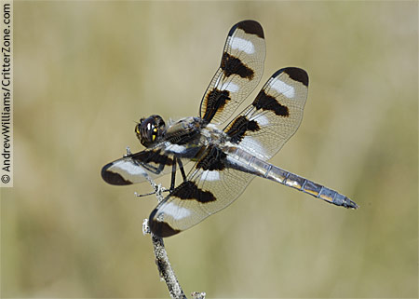
Dragonfly Adults
The adult dragonflies we see most often here are the Common Whitetail and the Twelve-spot Skimmer. Both of the pictures represent male dragonflies. The females of both of these dragonflies have duller colouration.
Common Whitetail
Twelve-spot Skimmer

Slide 20
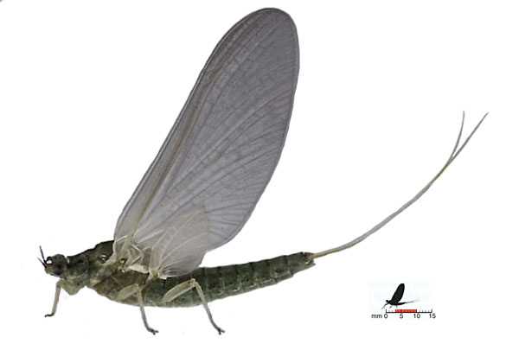

Mayfly Nymph
If mayfly nymphs are present in the aquatic ecosystem it indicates that the health of the ecosystem is good.
Mayfly nymphs require clean water that is well oxygenated, and excess nutrient levels cannot be tolerated.
Mayflies will soon disappear from ecosystems that are negatively affected by human activity. Scientists find these types of organisms to be good indicator species of environmental problems.
Adult
Nymph

Slide 21
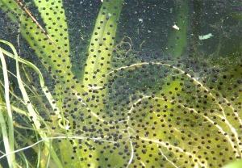
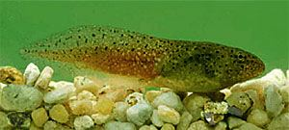
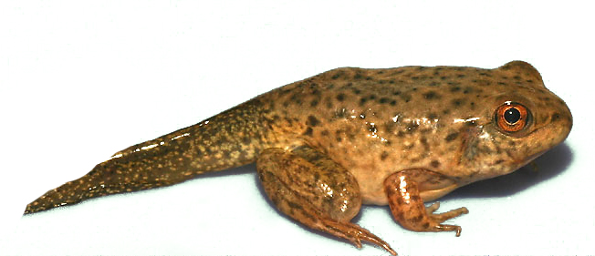
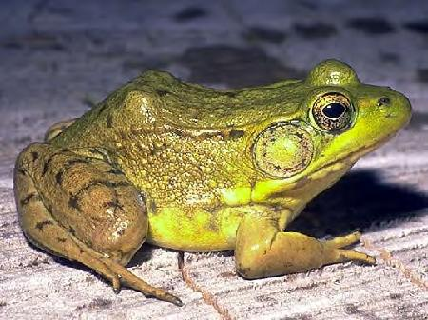
Amphibian Growth and Ecosystem Health
Tadpoles, like other amphibians, are sensitive to changes in water quality. Some species remain in this vulnerable stage for 2 or 3 years.
Tadpoles develop
from eggs laid in the Spring.
Most of the dots you see in this egg cluster
will become tadpoles in a healthy ecosystem.
When a tadpole’s legs appear it is called a froglet. Occasionally froglets are found with mutations caused by contaminants.
If the contamination is sufficient, adult frogs will not be observed or will be less numerous, since the egg, tadpole or froglet stage has been harmed by pollutants or toxins.

Slide 22
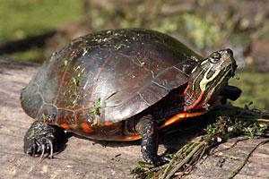
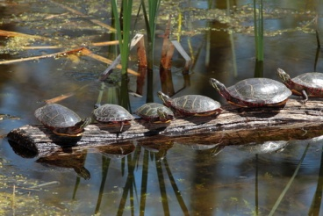
Painted Turtle
Turtles are not as sensitive as frogs are to changes in abiotic factors that cause negative ecological impacts. This is due to the fact that reptile skin doesn’t allow water to enter it as does amphibian skin. Therefore amphibians are better indicators of chemical changes affecting aquatic ecosystem health.
Painted turtles basking in the sun.

Slide 23
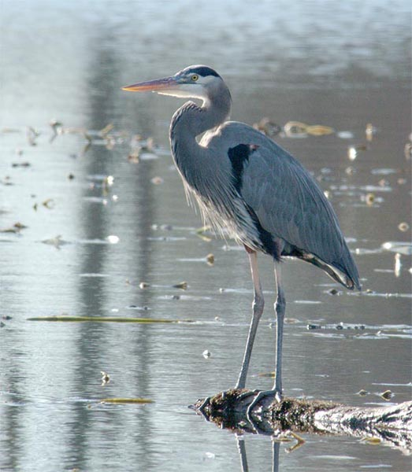
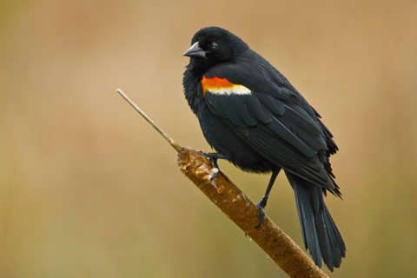
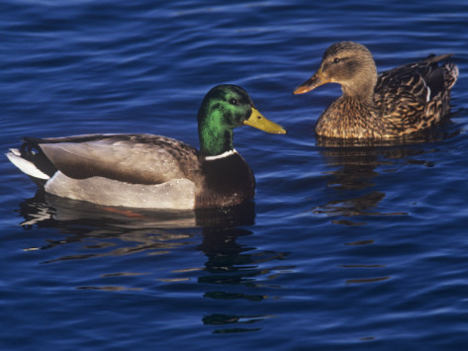
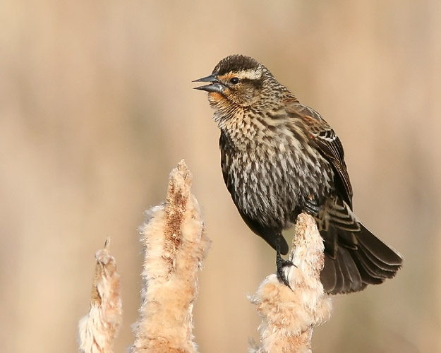
Our Marsh Birds
Mallard Duck
Great Blue Heron
Ducks rely on native plants and organisms as well. Ducks act to recycle nutrients, spread seeds, control insects, and provide food for many species. Invasive species and pollution affect our ducks as well however, and some duck species are decreasing in number as a result.
Since the great blue heron is a predator, it accumulates many of the toxins present in the environment. Because it preys mainly on aquatic organisms, its fatty tissues can tell us what contaminants may be a problem in our aquatic ecosystem.
Red-Winged Blackbird
These birds need native wetland plants to build their nests and wetland insects to feed their young. Unfortunately, invasive plant species are taking over our wetlands, harming many native species.

Slide 24
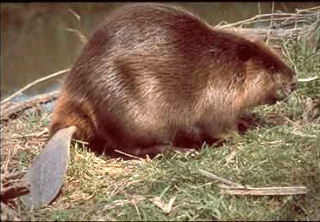



Wetland Mammals
Beaver
Muskrat
Look at that huge flat tail! Beaver use this to signal others in their community when danger is near. Beaver lodges are made of mud and sticks, and often there is a beaver dam nearby. Beaver dams block streams and rivers to create great wetland habitat for thousands of organisms.
Muskrat rely on plants like cattail to build their nests and provide their food. Roots, leaves and stems provide all the muskrat needs to survive. Muskrat houses look like mounds sticking out of the water but there aren’t any sticks in these mounds, just cattails.

Slide 25
Wetlands – Examples of Important Aquatic Ecosystems

Slide 26





Water + Land = Wetland
Types of Wetlands
Cattails, reeds and sedges + water = Marsh
Trees, water-loving plants + water = Swamp
Grasses, sedges, low shrubs and mosses + surface water = Fen
Sphagnum moss and carnivorous plants + rainwater = Bog
Sphagnum Moss
Sundew

Slide 27

What Do Wetlands Do for Us?
Just like the plants in the marshes, wetlands themselves act to:
.
Prevent flooding since they absorb floodwater like sponges.
Recharge the water table when droughts occur.
Prevent soil erosion by slowing down the flow of water.
Reduce pollution- plants absorb and store it and bacteria breaks it down.
Provide wildlife habitat and clean water for us all to enjoy!
Notes:
Prevent flooding since they absorb floodwater like sponges.
Recharge the water table when droughts occur.
Prevent erosion by holding the soil in place with plant roots and slowing down the flow of water.
Reduce the amount of pollutants in the water since these are absorbed and stored in the plant tissues.
Provide habitat and clean water for wildlife and for us to enjoy!

Slide 28



Challenges Facing Our Wetlands
Bioaccumulation, or the uptake of toxin (i.e. PCBs) occurring at one trophic level, is taking place at each level of the food chain. (i.e. fish eats many worms and toxin builds up in that fish’s fatty tissues)
Good indicator species for aquatic toxins.
Biodiversity (the variety of life forms) is being severely reduced by many causes.
Toxins are one cause and these are increasing along with their impacts on ecosystem health and indicator species.
Bioaccumulation and biomagnification of these toxins are occuring within organisms in our aquatic ecosystems.
Biomagnification, or the increase of toxin in the fatty tissues of each successive organism, occurs all the way up the food chain! The top predator (eagle) contains the most toxin while each of the lowest (plankton) contain a small amount of toxin.
Unhealthy
Healthy
The result, organisms harmed and unable to survive in their ecosystem.
Notes:
Talk about good indicator species to give warnings about acid problems (i.e. flathead minnow, clams, snails, rainbow trout

Slide 29







Other Threats to Our Wetlands and Aquatic Ecosystems
Air and water pollution
Surface runoff carrying agricultural fertilizers
Invasive species
Urban and rural development
Destruction of forests and aquatic “buffer zones”
Land surface, shoreline and bank erosion

Slide 30






Without Wetlands We Have to:
Build and Plant Erosion Control-$$$$$
Build Dykes and Channels-$$$$$
Build Expensive Dams - $$$$$
Lose Many Types of Wildlife and Wild Areas
Install Systems to Water Our Crops - $$$$$
Treat and Clean Our Water - $$$$$

Slide 31





Protecting All Aquatic Ecosystems is Important!
For Ourselves and for Others!

Slide 32

This presentation was made possible by
Help Conserve Our Natural Resources!
© Lower Thames Valley Conservation Authority 2016
No part of this presentation is to be copied or shared without permission.

